Slide 1

The Proxy Romberg Ratio in Repeated-Trial Stabilometry
01.04.02 Applied Mathematics and Computer Science
Student: [Student Name, Group]
Scientific Supervisor:
[Supervisor Name, title]
Scientific Advisor:
[Advisor Name, title]

Slide 2
Statement of the Problem
The Romberg test quantifies postural control by comparing sway with eyes open (EO) and eyes closed (EC). In quantitative posturography it is reported as a ratio of a center-of-pressure (CoP) sway measure — path length, sway velocity, or sway area.
The problem: on repeated trials the ratio is not a single number.
Ratio of means, mean of paired ratios, and robust (bootstrap) estimators give different values for the same data, and stability depends on which CoP feature is chosen — yet the estimator is rarely reported.
Why the scientific track?
This ambiguity undermines the reproducibility and cross-study comparability of a widely used clinical index. Resolving it needs explicit estimator definitions and a reliability/validity analysis — a methodological contribution, not a new device.
Data note: the available dataset has no EO/EC condition, so we study a transparent proxy Romberg ratio (high- vs low-sway trials within one condition) and state plainly that it is not a physiological Romberg ratio.

Slide 3
Purpose and Objectives
Purpose: determine how the choice of estimator affects the repeated-trial Romberg coefficient, and whether a reliable, low-dimensional individual profile can be recovered from it.
Objectives
Formalise and compare four repeated-trial estimators — ratio of means, mean of paired ratios, bootstrap median, and geometric mean — and quantify their disagreement.
Quantify reliability and generalizability with ICC, Cronbach’s α, SEM/SDC, and generalizability theory.
Test latent structure and individual profiles via PCA, a one-factor model, k-means clustering, and the adjusted Rand index.
Derive standardization recommendations for reporting Romberg-type indices in research and clinical practice.

Slide 4
Review of Similar Solutions/Research
Prior work supplies the building blocks but not a unified treatment of repeated-trial Romberg estimation.
Prieto et al. (1996), IEEE TBME. Standardised CoP posturography measures. Limitation: single-condition; no repeated-trial ratio estimation.
Grokhovsky & Kubryak (2018). Integral energy-expenditure index from CoP kinematics. Limitation: absolute index, not a reliability framework.
Bland & Altman (1986); Shrout & Fleiss (1979); Cronbach (1951); Brennan (2001). Agreement, ICC, internal consistency, and generalizability theory. Limitation: never combined for repeated-trial Romberg estimators.
Research gap: no prior work systematically compares repeated-trial Romberg estimators and quantifies their reliability and latent structure.

Slide 5
Research Methods and Tools
Methods
Per-trial CoP feature extraction — 24 measures (amplitude, geometry, velocity, frequency, complexity) plus the Grokhovsky–Kubryak energy index.
Proxy design — per-subject median split into 5 low- vs 5 high-sway trials (5 paired ratios).
Four estimators + Bland–Altman agreement on ln(pRR).
Reliability & structure — Cronbach’s α, PCA, one-factor model, ICC(2,1), SEM/SDC, two-facet generalizability theory, bootstrap.
Clustering — k-means with adjusted-Rand stability across estimators and split-features.
Tools
Python — pandas, NumPy, SciPy, scikit-learn, PyArrow, matplotlib.
Data: internal CoP dataset (SQLite metadata + Parquet time series; 250 Hz, 30 s trials).

Slide 6
Scientific Novelty (assessed on the basis of a scientific project)
The project is novel in four ways within the context of existing research.
First explicit mathematical comparison of repeated-trial Romberg estimators, with disagreement quantified by Bland–Altman analysis on the log scale.
Joint reliability and generalizability treatment of a Romberg-type index — showing single-trial ratios are only fairly reliable while multi-trial aggregates are good.
A near-unidimensional curated battery and reproducible individual profiles, stable across estimators and labelling rules.
A transparent proxy framing and a concrete standardization recommendation (geometric mean on the log scale).

Slide 7
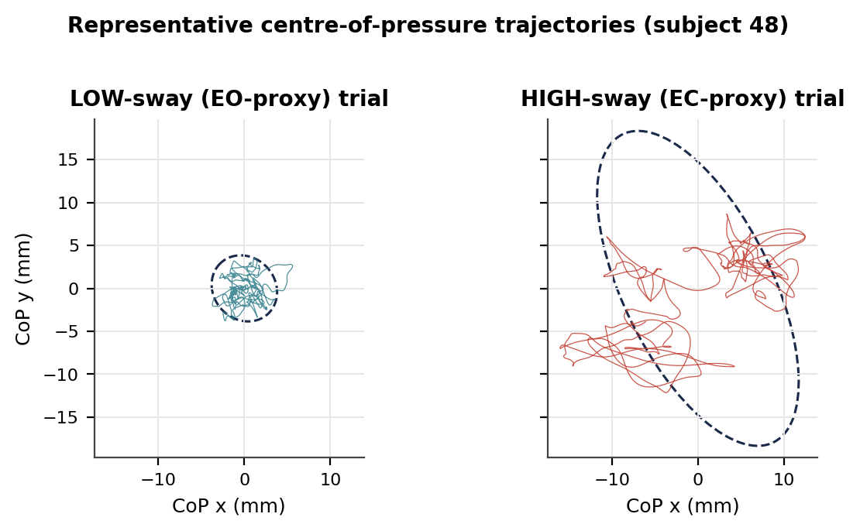
The Solution Flow
From data to paired ratios
Inclusion. 124 subjects → 85 with free-condition trials → 80 with ≥10 trials (balanced 5+5 design). 250 Hz, 30 s (~7500 samples).
Features. 24 per-trial CoP measures across six families; energy index in the exact Grokhovsky–Kubryak form.
Proxy labelling. Per-subject median split of a sway feature → 5 LOW vs 5 HIGH trials → five paired trialwise ratios Ri.
Right: a low-sway and a high-sway trial from one subject (95% ellipses) — the contrast the median split encodes.

Slide 8
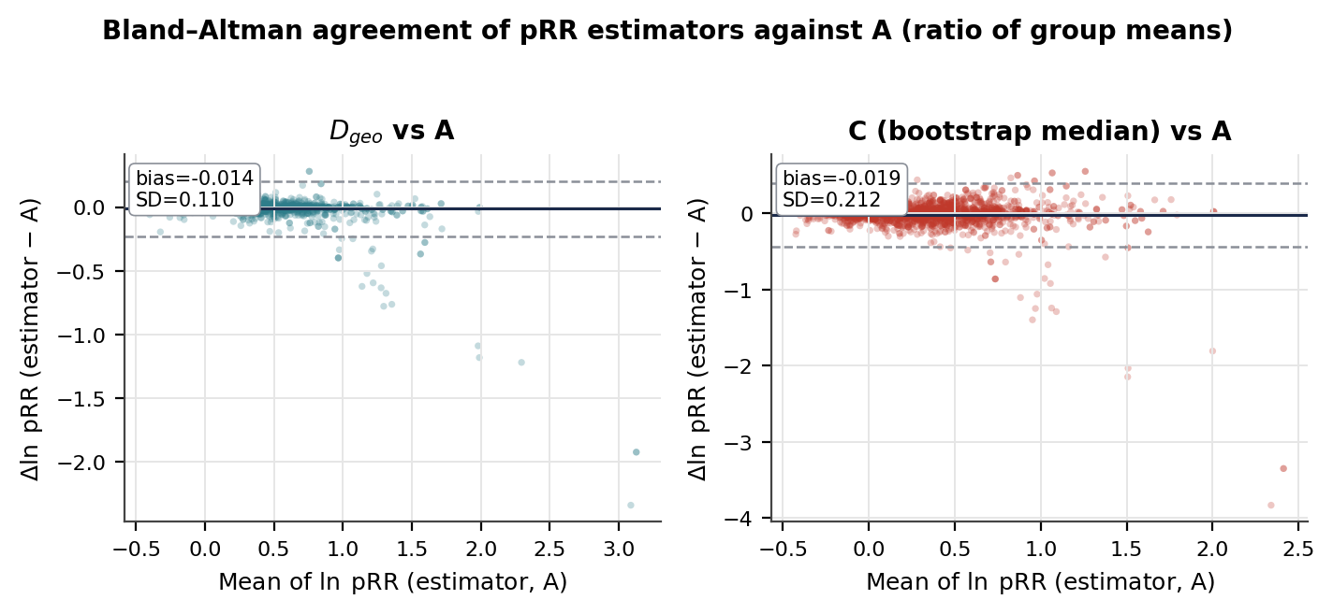
The Solution Flow (continued)
Estimators and statistical pipeline
Estimators. A = mean(HIGH)/mean(LOW); B = mean of Ri; C = bootstrap median; D = geometric mean exp(mean ln Ri).
Agreement. Bland–Altman on ln(pRR) against A: bias, limits of agreement, MSE (right).
Structure & reliability. Cronbach’s α, PCA / one-factor model; ICC, SEM/SDC, generalizability theory; k-means + ARI.
Robustness. The whole pipeline is repeated across five split-features.

Slide 9
Key Results:
Estimator choice measurably changes the ratio. The geometric mean D tracks the conventional ratio of means (MSEln ≈ 0.011–0.012, SD ≈ 0.11); the bootstrap median is ~2× more dispersed.
Near-unidimensional curated battery. PC1 explains ≈ 96–98% of variance; a one-factor model reconstructs it with RMSE ≈ 0.20.
Reliability. Single trial is only fair (ICC ≈ 0.37–0.43); the 5-trial mean is good (Cronbach α ≈ 0.76–0.80); generalizability Eρ² = 0.76.
Two reproducible profiles. k = 2 throughout; recovered across estimators and split-features (ARI up to 1.0).
Open repository: [github— analysis code, experiments, and a formatted README; to fill]

Slide 10
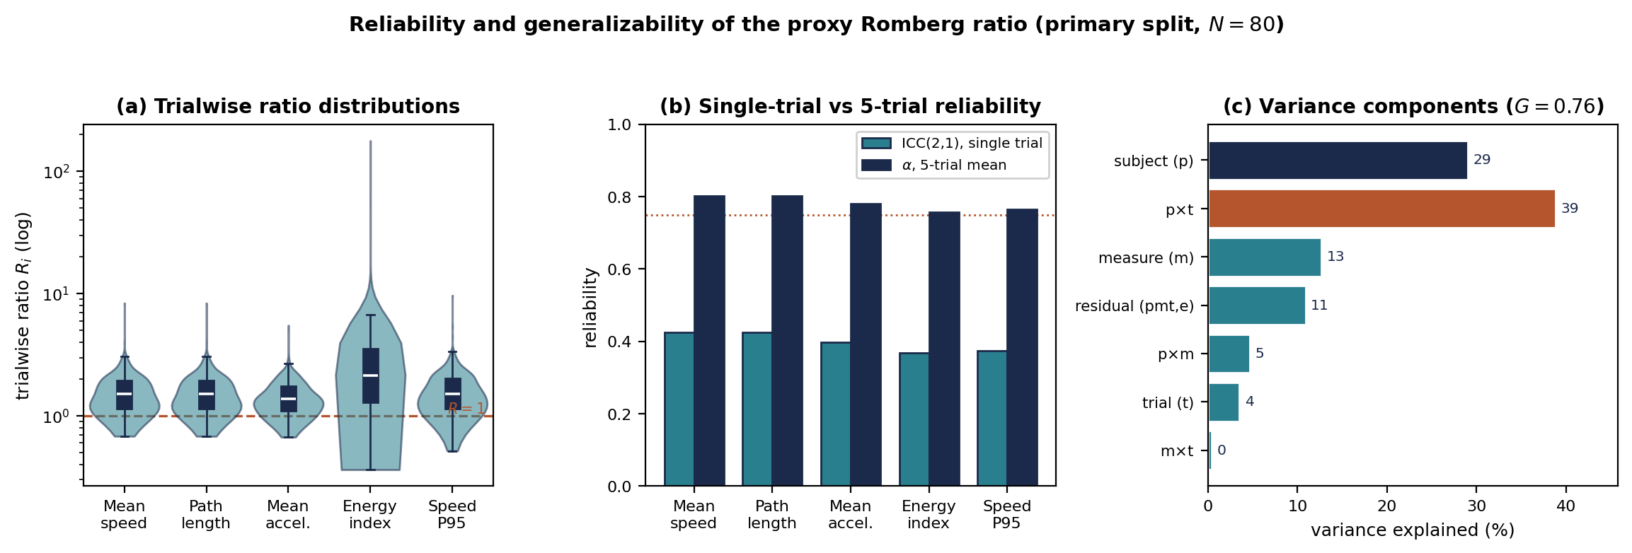
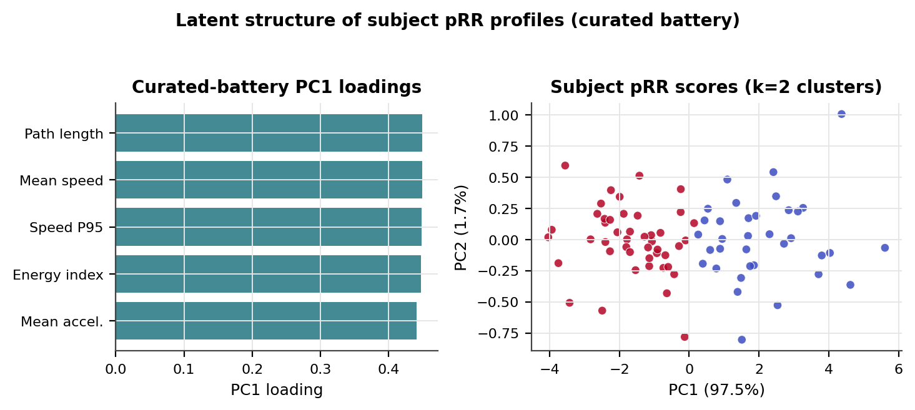
Key Results:
Reliability, generalizability, and subject profiles
Left: single-trial vs 5-trial reliability and the generalizability variance split (subject×trial dominates, 39%; G = 0.76).
Right: two subject clusters separate cleanly along PC1.
The same two-profile partition recurs across all five split-features — evidence of a genuine person-level property, not a labelling artifact.

Slide 11
Key Results: estimator agreement
Bland–Altman agreement of each estimator against A (ratio of group means), on ln(pRR).
N = 80, 24 measures per split-feature; lower = closer to the conventional ratio.
MSE = mean squared log-difference, SD = limits-of-agreement dispersion. D (geometric mean) is the most stable nontrivial estimator; C (bootstrap median) the most dispersed.
Split feature | MSE (B) | SD (B) | MSE (C) | SD (C) | MSE (D) | SD (D)
ellipse_area95_m2 | 0.0041 | 0.0529 | 0.0454 | 0.2124 | 0.0123 | 0.1100
mean_speed_mps | 0.0048 | 0.0586 | 0.0398 | 0.1987 | 0.0113 | 0.1056
path_length_m | 0.0048 | 0.0586 | 0.0398 | 0.1987 | 0.0113 | 0.1056
rms_total_m | 0.0061 | 0.0664 | 0.0442 | 0.2098 | 0.0122 | 0.1094
speed_p95_mps | 0.0051 | 0.0599 | 0.0370 | 0.1917 | 0.0107 | 0.1029

Slide 12
Key Results: reliability & generalizability
Trial-level reliability of the proxy Romberg ratio (primary split, N = 80, balanced 5×5, on ln R).
ICC(2,1) single-trial reliability; α₅ Cronbach’s alpha of the 5-trial mean; SEM, SDC in ln units;
CV within-subject variation (variant D); VC contrast fraction 1−1/R.
Measure | ICC(2,1) | α₅ | SEM (ln) | SDC (ln) | CV | VC
Mean speed | 0.43 | 0.80 | 0.26 | 0.71 | 0.24 | 0.31
Path length | 0.43 | 0.80 | 0.26 | 0.71 | 0.24 | 0.31
Mean accel. | 0.40 | 0.78 | 0.24 | 0.66 | 0.22 | 0.26
Energy index | 0.37 | 0.76 | 0.57 | 1.57 | 0.47 | 0.48
Speed P95 | 0.37 | 0.76 | 0.29 | 0.82 | 0.27 | 0.32
Generalizability — variance components (% of total), Eρ² = 0.76 (5 measures × 5 trials)
Subject (p) | p × t | Measure (m) | Residual | p × m | Trial (t) | m × t
29% | 39% | 13% | 11% | 5% | 4% | 0.4%
The subject×trial interaction dominates the variance — trial-to-trial variability is the main noise source, which is why a single ratio is only fairly reliable while the 5-trial aggregate is good.

Slide 13
Key Results: consistency, dimensionality & clustering
Across split-features (N = 80). α Cronbach’s alpha; PC1 first-component variance; k silhouette-selected clusters; sil silhouette; ARI adjusted Rand index of each estimator’s clustering vs D. (all = 24-measure battery; cur = curated 5-measure battery.)
Split feature | α (all) | PC1 (all) | α (cur) | PC1 (cur) | k | sil | ARI (A) | ARI (B) | ARI (C)
ellipse_area95_m2 | 0.948 | 0.598 | 0.964 | 0.975 | 2 | 0.578 | 0.808 | 0.901 | 0.719
mean_speed_mps | 0.946 | 0.564 | 0.960 | 0.960 | 2 | 0.505 | 0.854 | 1.000 | 0.557
path_length_m | 0.946 | 0.564 | 0.960 | 0.960 | 2 | 0.505 | 0.854 | 1.000 | 0.557
rms_total_m | 0.951 | 0.608 | 0.965 | 0.977 | 2 | 0.558 | 0.853 | 0.901 | 0.520
speed_p95_mps | 0.949 | 0.569 | 0.960 | 0.960 | 2 | 0.501 | 0.854 | 1.000 | 0.719

Slide 14
Expected Results / Next Steps
Planned extensions (second semester) and publication.
External validation against an annotated EO/EC dataset — relate the proxy to the physiological Romberg ratio.
Hierarchical Bayesian model — partial pooling to stabilise noisy per-subject estimates and propagate uncertainty.
Trial-count guidance from generalizability theory — how many trials a target reliability requires.
Publication — submit the manuscript to a peer-reviewed journal (e.g., Sensors) within three months.

Slide 15
Conclusion
The proxy Romberg ratio is estimator-dependent — but its latent structure is robust.
Recommend the geometric mean on the log scale, a small curated battery, and explicit reporting of the estimator and the trial count.
Single-trial reliability is only fair, so several trials must be aggregated (Eρ² = 0.76 at five trials).
Two reproducible subject profiles emerge, stable across estimators and split-features.
Deliverables: open code repository, journal-template preprint, and this presentation.

Slide 16

THANK YOU FOR YOUR TIME!

